Slide 1

Hardware Accelerated Neural Networks

Slide 2
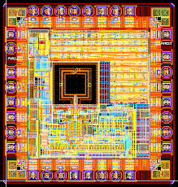
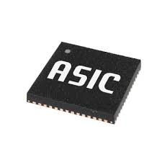
Proposal: Application Specific Integrated Circuit (ASIC) That Accelerates Machine Learning
Hardware Acceleration – use of specialized computer hardware to perform a task
Designing an ASIC for a task can have increased performance over a CPU or GPU

Slide 3
Why?
Processing a neural network is a very parallel task
Many applications rely on machine learning
As time goes on, we will need faster more efficient hardware

Slide 4
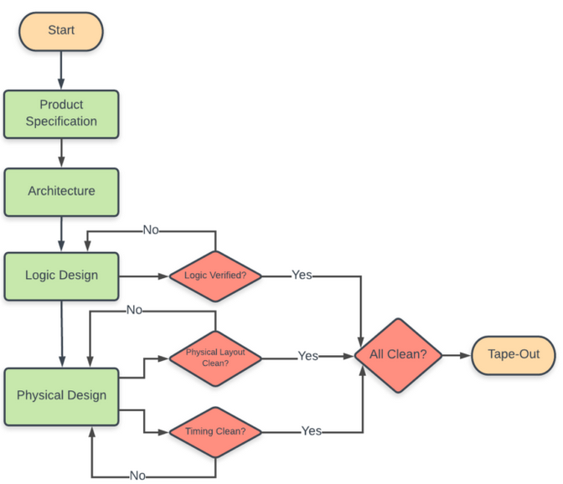
Development Time
Can take anywhere from 6 months to 2 years to design depending on if the design is full custom or not.

Slide 5
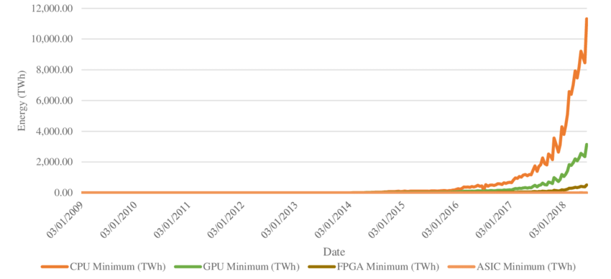
Benefits
Highly parallelable
Space efficient
Power efficient
Time efficient

Slide 6
Development Cost
FPGA Conversion: $35k at the lowest for 10k units per year
Normal ASIC: Minimum $0.5 Million
Full Custom: A lot money

Slide 7
Competition
Field Programable Gate Arrays (FPGAs)
Very versatile
Hard to find people to program them
Graphics Processing Unit (GPU)
Industry standard
Easier to program

Slide 8
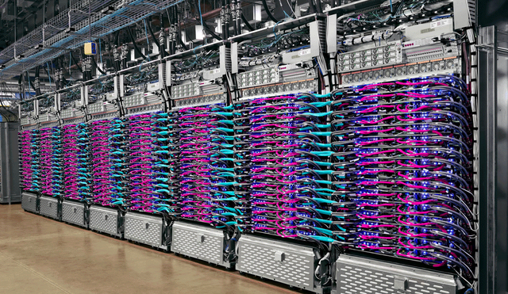
Uniqueness
The only real investment in hardware accelerated AI is Google TPU
Boast 27 times faster training at 38% of the cost of 8 V100 GPUs

Slide 9
Likelihood of Success
GPUs are still at the forefront of AI and likely will be for the foreseeable future
As AI becomes more widespread, faster and more efficient solutions will be needed.
Likelihood of success right now is low but would be much higher in the future.

